Slide 1
Quantum Algorithm The Power of Quantum Computing
Deutsch-Jozsa Algorithm

Slide 2
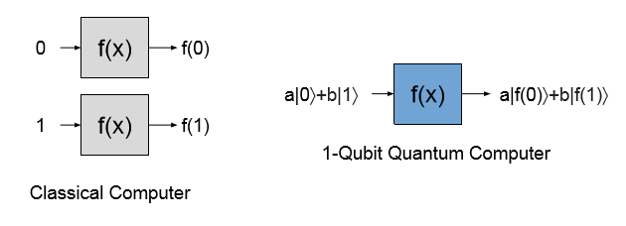
Quantum Algorithm The Power of Quantum Computing
It takes a classical computer two
to operate on two pieces of information
A quantum computer with one qubit can operate on two classical pieces of information at once
The main advantage that quantum computers have over classical computers is parallelism

Slide 3
Quantum Algorithm The Power of Quantum Computing
It takes a classical computer two
to operate on two pieces of information
A quantum computer with one qubit can operate on two classical pieces of information at once
The main advantage that quantum computers have over classical computers is parallelism
Because qubits can be in a superposition of states, a quantum computer can perform an operation on all of the states simultaneously

Slide 4
Quantum Algorithm The Power of Quantum Computing
It takes a classical computer two
to operate on two pieces of information
A quantum computer with one qubit can operate on two classical pieces of information at once
The main advantage that quantum computers have over classical computers is parallelism
Because qubits can be in a superposition of states, a quantum computer can perform an operation on all of the states simultaneously
Let’s say we want to know the result of applying some function f(x) to some number x. Two classical computations are needed to ﬁnd the result for x = 0 and for x = 1, whereas a quantum computer can evaluate both answers in parallel as displayed in the above Figure

Slide 5
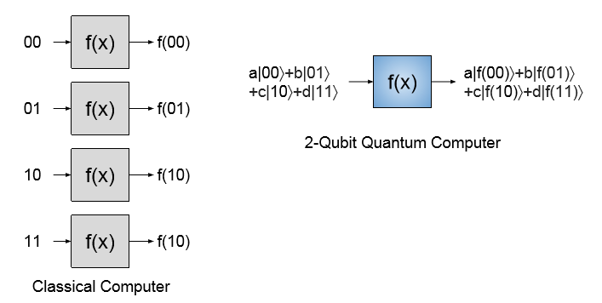
Quantum Algorithm The Power of Quantum Computing
It takes a classical computer four operations
to operate on four pieces of information
A quantum computer with two-qubits can operate on four classical pieces of information at once

Slide 6
Quantum Algorithm The Power of Quantum Computing
It takes a classical computer four operations
to operate on four pieces of information
A quantum computer with two-qubits can operate on four classical pieces of information at once
If we wanted to compute f(x) for x=2(represented as10 in binary) and x=3 (representedas11),we would need to add a second qubit. The two-qubit quantum computer can then evaluate all four possibilities at once as shown in the Figure above

Slide 7
Quantum Algorithm The Power of Quantum Computing
Question1: How many pieces of information can at three-qubit quantum computer process in parallel?

Slide 8
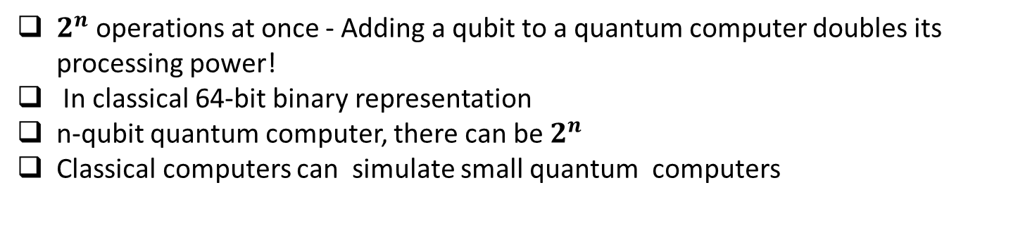
Quantum Algorithm The Power of Quantum Computing
Question1: How many pieces of information can at three-qubit quantum computer process in parallel?
Write down all of the states. They are:
|000>,|001>,|010>,|100i,|011>,|110>,|101>,|111> →8 pieces of information.
$2^{n}$ operations at once - Adding a qubit to a quantum computer doubles its processing power!
In classical 64-bit binary representation
n-qubit quantum computer, there can be $2^{n}$
Classical computers can simulate small quantum computers

Slide 9

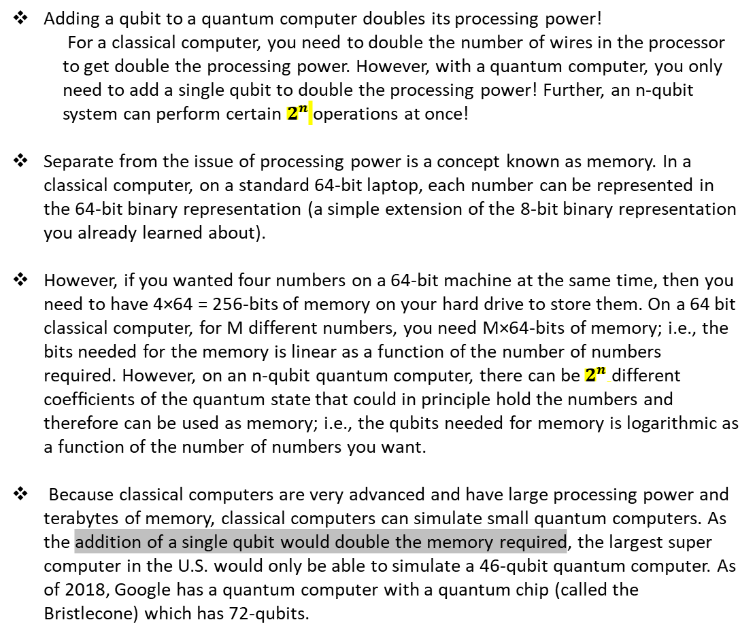
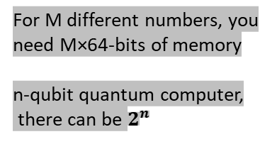
Quantum Algorithm The Power of Quantum Computing
Adding a qubit to a quantum computer doubles its processing power!
For a classical computer, you need to double the number of wires in the processor to get double the processing power. However, with a quantum computer, you only need to add a single qubit to double the processing power! Further, an n-qubit system can perform certain $2^{n}$ operations at once!
Separate from the issue of processing power is a concept known as memory. In a classical computer, on a standard 64-bit laptop, each number can be represented in the 64-bit binary representation (a simple extension of the 8-bit binary representation you already learned about).
However, if you wanted four numbers on a 64-bit machine at the same time, then you need to have 4×64 = 256-bits of memory on your hard drive to store them. On a 64 bit classical computer, for M different numbers, you need M×64-bits of memory; i.e., the bits needed for the memory is linear as a function of the number of numbers required. However, on an n-qubit quantum computer, there can be $2^{n}$different coefﬁcients of the quantum state that could in principle hold the numbers and therefore can be used as memory; i.e., the qubits needed for memory is logarithmic as a function of the number of numbers you want.
Because classical computers are very advanced and have large processing power and terabytes of memory, classical computers can simulate small quantum computers. As the addition of a single qubit would double the memory required, the largest super computer in the U.S. would only be able to simulate a 46-qubit quantum computer. As of 2018, Google has a quantum computer with a quantum chip (called the Bristlecone) which has 72-qubits.
$2^{n}$ operations at once
In classical 64-bit binary
representation
For M different numbers, you
need M×64-bits of memory
n-qubit quantum computer,
there can be $2^{n}$
Classical computers can
simulate small quantum
computers

Slide 10
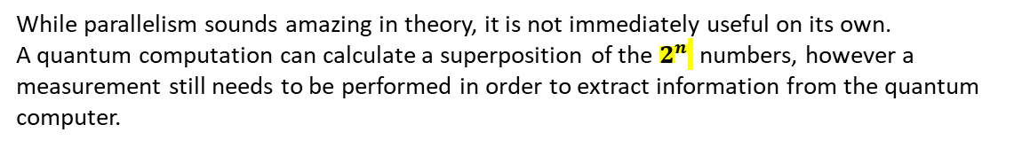
Limitations
While parallelism sounds amazing in theory, it is not immediately useful on its own.
A quantum computation can calculate a superposition of the $2^{n}$ numbers, however a measurement still needs to be performed in order to extract information from the quantum computer.
a |f(00) > + b |f(01)> + c |f(10) > + d |f(11)>
a |f(00) > + b |f(01)> + c |f(10) > + d |f(11)>
f(00), f(01), f(10), OR f(11).
… Quantum computers are therefore only practical for certain types of problems
…. it is generally accepted that quantum computers will not replace classical computers but will be able to perform different calculations that classical computers simply cannot

Slide 11
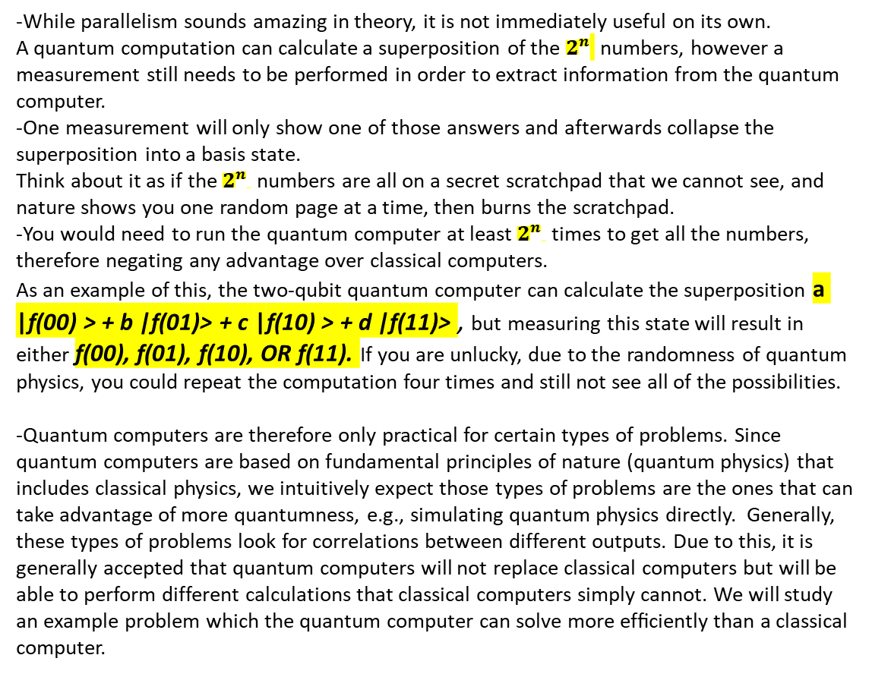
Limitations
-While parallelism sounds amazing in theory, it is not immediately useful on its own.
A quantum computation can calculate a superposition of the $2^{n}$ numbers, however a measurement still needs to be performed in order to extract information from the quantum computer.
-One measurement will only show one of those answers and afterwards collapse the superposition into a basis state.
Think about it as if the $2^{n}$ numbers are all on a secret scratchpad that we cannot see, and nature shows you one random page at a time, then burns the scratchpad.
-You would need to run the quantum computer at least $2^{n}$ times to get all the numbers, therefore negating any advantage over classical computers.
As an example of this, the two-qubit quantum computer can calculate the superposition a |f(00) > + b |f(01)> + c |f(10) > + d |f(11)> , but measuring this state will result in either f(00), f(01), f(10), OR f(11). If you are unlucky, due to the randomness of quantum physics, you could repeat the computation four times and still not see all of the possibilities.
-Quantum computers are therefore only practical for certain types of problems. Since quantum computers are based on fundamental principles of nature (quantum physics) that includes classical physics, we intuitively expect those types of problems are the ones that can take advantage of more quantumness, e.g., simulating quantum physics directly. Generally, these types of problems look for correlations between different outputs. Due to this, it is generally accepted that quantum computers will not replace classical computers but will be able to perform different calculations that classical computers simply cannot. We will study an example problem which the quantum computer can solve more efﬁciently than a classical computer.
a |f(00) > + b |f(01)> + c |f(10) > + d |f(11)>

Slide 12

Deutsch-Jozsa Algorithm
Here we give a proof that quantum computers can be faster than classical computers by explicit construction of a problem.
The Problem
Let f(x) be an unknown function that operates on a single qubit. There can only be four different functions that satisfy this requirement, and the four different functions are shown in Table:
There are only four possible single qubit functions.
The question posed to the computer is this:
"Is f(x) going to output the same two numbers or opposite numbers?"
A function is called constant if it always outputs the same result for all values of x.
A function is called balanced if it outputs1for half of all the possible values of x and 0 for the other half.

Slide 13
Deutsch-Jozsa Algorithm
Here we give a proof that quantum computers can be faster than classical computers by explicit construction of a problem.
The Problem
Let f(x) be an unknown function that operates on a single qubit. There can only be four different functions that satisfy this requirement, and the four different functions are shown in Table:
There are only four possible single qubit functions.
The question posed to the computer is this:
"Is f(x) going to output the same two numbers or opposite numbers?"
A function is called constant if it always outputs the same result for all values of x. A function is called balanced if it outputs1for half of all the possible values of x and 0 for the other half.
Question 1 : Which of the functions in Table are constant and which are balanced?
The functions f1 and f4 are constant, while f2 and f3 are balanced.
Question 2: If you run the classical algorithm and see that f(0) = 1, could you tell whether the function is constant or balanced?
No, it could either be the balanced function f3 or the constant function f4. A classical computer would have to evaluate both f(0) and f(1) to determine the answer

Slide 14
Deutsch-Jozsa Algorithm
Quantum Solution
Procedure:
1. Put a qubit in a superposition of 0 and 1 with a Hadamard gate.
2. Operate on the qubit with the unknown function.
3. Apply another Hadamard gate.
4. Measure the qubit’s state.
A single measurement will tell you whether the function was
constant or balanced.

